Slide 1
Organs Associated with the Digestive Tract

Slide 2
introduction
The organs associated with the digestive tract include the major salivary glands, the pancreas, the liver, and the gallbladder.
Products of these organs facilitate transport and digestion of food within the gastrointestinal tract.

Slide 3
The liver
Anatomically :
The liver is the largest internal organ, in adults averaging about 1.5 kg or 2% of the body weight
Located in the right upper quadrant of the abdomen just below the diaphragm.
The liver has major left and right lobes with two smaller inferior lobes, most of which are covered by a thin capsule and mesothelium of the visceral peritoneum.

Slide 4
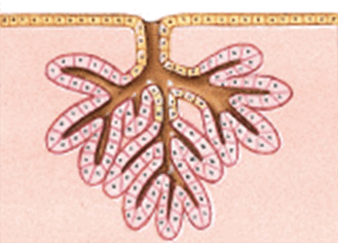
The capsule thickens at the hilum (or porta hepatis) on the inferior side, where the dual blood supply from the hepatic portal vein and hepatic artery enters the organ and where the hepatic vein, lymphatics, and common hepatic (bile) duct exit.
About 75% of the blood entering the liver is nutrient rich (but O2-poor) blood from the portal vein arising from the stomach, intestines, and spleen; the other 25% comes from the hepatic artery and supplies the organ’s O2.
Histologically :
It is a mixed gland organ , has both endocrine and exocrine functions ( compound tubular gland)

Slide 5
Functions of the liver
production of bile : this is the main digestive function of the liver, the bile is a complex substance required for the emulsifcation, hydrolysis, and uptake of fats in the duodenum.
The liver is the major interface between the digestive system and the blood, as the organ in which nutrients absorbed in the small intestine are processed before distribution throughout the body.
Synthesis and endocrine secretion into the blood of the major plasma proteins, including albumins, fibrinogen, apolipoproteins, transferrin, and many others.
Conversion of amino acids into glucose (gluconeogenesis)
Breakdown (detoxifcation) and conjugation of ingested toxins, including many drugs.
Amino acid deamination, producing urea removed from blood in kidneys.

Slide 6
Storage of glucose in glycogen granules and triglycerides in small lipid droplets.
Storage of vitamin A (in hepatic stellate cells) and other fat-soluble vitamins.
Removal of eﬀete erythrocytes (by specialized macrophages, or Kupﬀer cells).
Storage of iron in complexes with the protein ferritin.

Slide 7
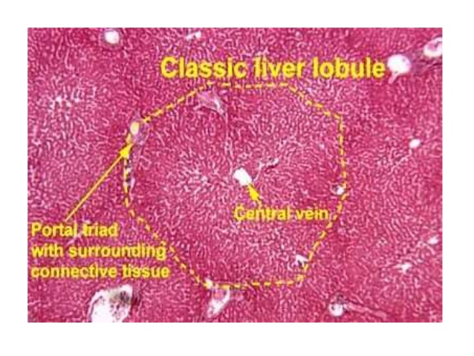
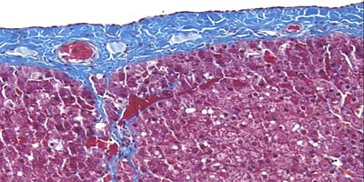
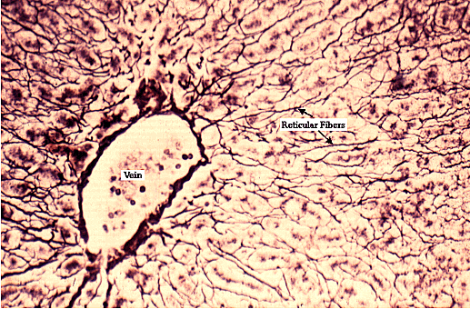
Structures of the liver
1.Stroma
Connective tissue capsule: called Glisson capsule which is partially covered by mesothelium
Connective tissue septa : arise at the hilum (porta hepatis) , divide the liver into lobules,
But the lobular organization is not evident in human .
Reticular fiber : support the parenchyma

Slide 8
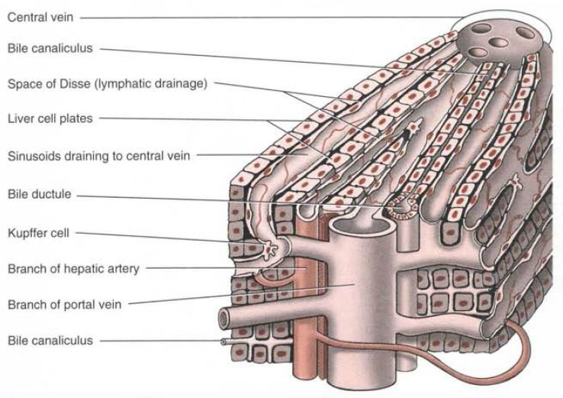
Structure of the liver
2.parenchyma:
Hepatocytes: the key cells of this organ, are among the most functionally diverse cells of the body.
Arranged in anastomosing cords, radiating from central vein. These hepatocyte cords enclose between them bile canaliculi and are separated from each other by blood sinusoids
Blood sinusoids

Slide 9
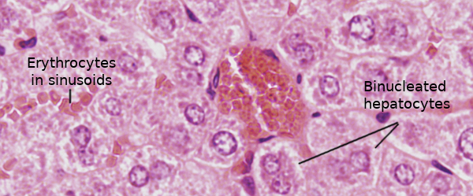
I. Hepatocytes
LM
Shape: Large cuboidal or polyhedral epithelial cells.
Nucleus: large, round central nuclei , The cells are frequently binucleated and about 50% of them are polyploid.
Cytoplasm : eosinophilic cytoplasm( rich in mitochondria and sER) and pale (presence of glycogen and lipid droplets).

Slide 10
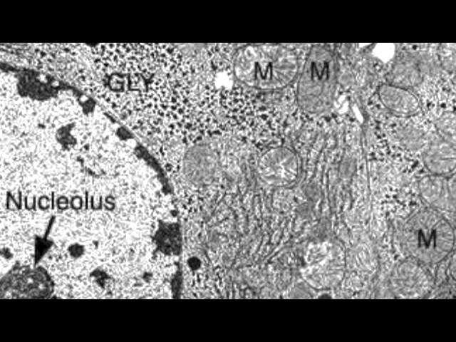
How hepatocyte adapt to its function
EM:
Abundant mitochondria(high metabolic activities)
multiple Golgi apparatus(secretory function)
Well developed rER(plasma proteins)
Abundant sER(bile acid synthesis, glycogen, detoxification)
Numerous peroxisomes(oxidation of FA)
Lysosomes and lipofuscin pigments(aged cells)
Glycogen and energy

Slide 11
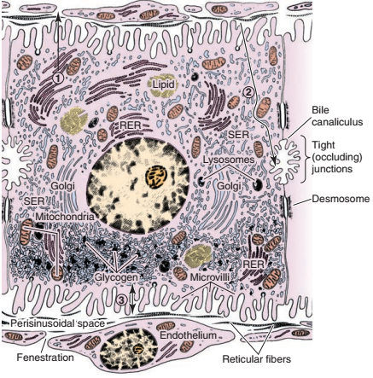
The hepatocyte
The hepatocyte has two functional surfaces:
1.Vascular surface:
Faces the perisinusoidal space
It shows long villi
2.The intercellular surface:
Where bile canaliculi are enclosed between
adjacent hepatocytes
Each bile canaliculus shows short microvilli
Projecting into its lumen and is bounded by tight
Junction and desmosomes.

Slide 12
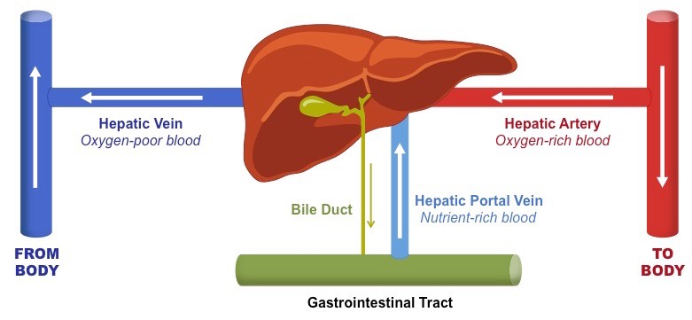
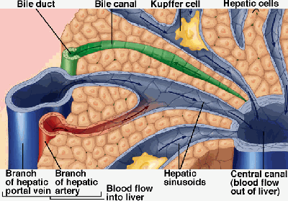
The blood sinusoids the blood supply of the liver
The liver has dual blood supply
On entering the porta hepatis, the portal vein and the hepatic artery interlobular branches(in the portal canals) the sinusoids
the central vein hepatic veins the inferior vena cava

Slide 13
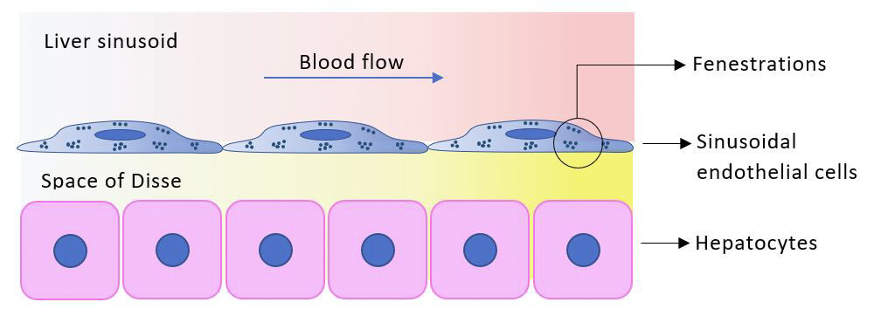
II.The blood sinusoids
Function: exchange between blood and hepatocytes
Structure: lined by two types of cells:
Endothelial cell:
Flat cells
Numerous large fenestration without diaphragm
Surrounded by discontinuous basal lamina
Function: this allow free passage of plasma to perisinusoidal space for the exchange process to occur.

Slide 14
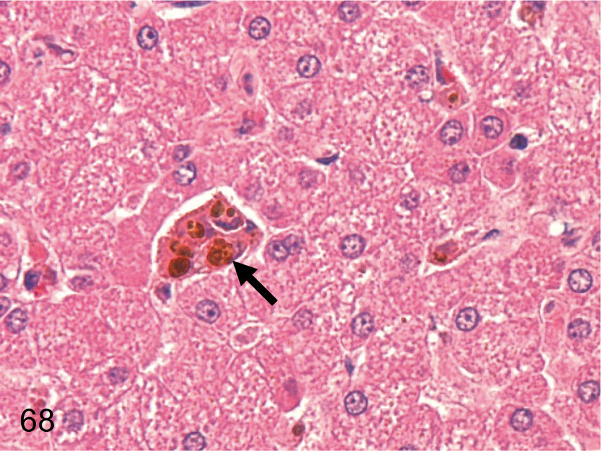
B.The kupffer cells
Origin : from blood monocytes
Structures:
Large branching cells
Their pseudopodia are projecting into the lumen of the sinusoids
The cytoplasm contain many lysosomes containing hemosiderin pigments.
Function: phagocytosis of aged RBCs

Slide 15
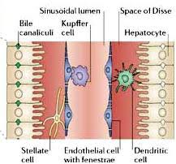
Space of Disse
Definition :it is anarrow perisinusoidal space between the endothelial lining of the sinusoids and the hepatocytes.
Function :it allows exchange of metabolites between the plasma and the hepatocytes
Contents:
1.Plasma filtered from the sinusoids
2.Microvilli projecting from the hepatocytes
3.Reticular fibers(support to the wall of sinusoids)
4.Hepatic stellate cells (Ito cells) :vitamin A storing cells.

Slide 16
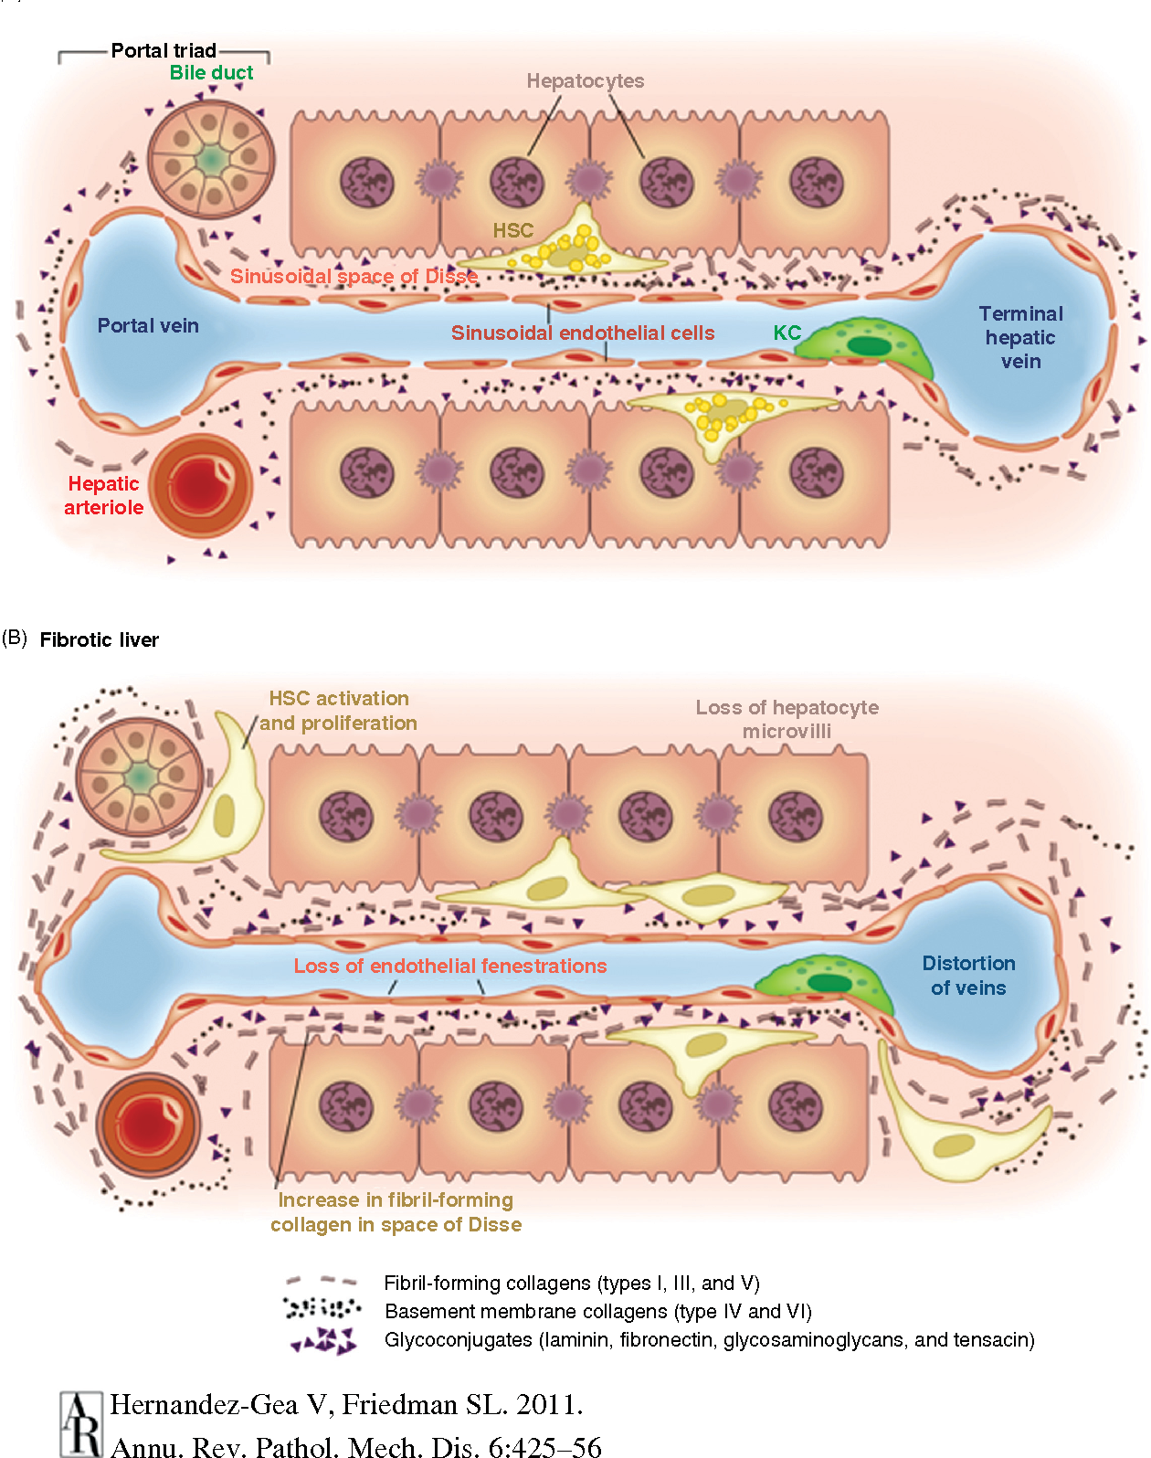
Hepatic stellate cells
In chronic inflammation of the liver,
these cells differentiate into myofibroblasts
and deposit excess collagen
into the perisinusoidal space resulting in liver fibrosis.

Slide 17
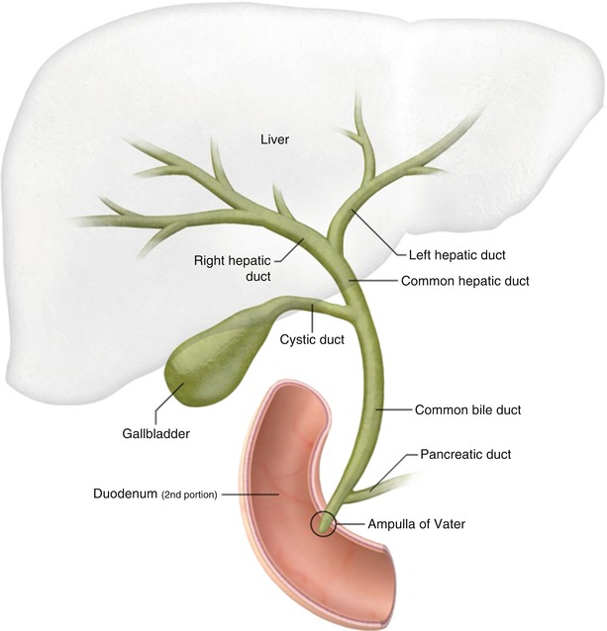
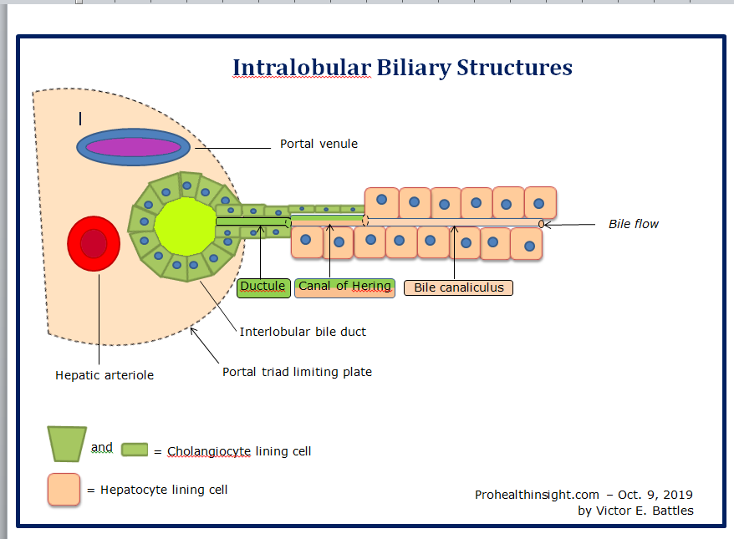
The biliary tree
The hepatocytes the bile canaliculi (lined by cell membrane of adjacent hepatocyte canals of Hering (lined by cuboidal cells) the interlobular bile ducts ( in the portal canals , lined by cuboidal cells then
columnar cells the Rt. And Lt. hepatic ducts.

Slide 18
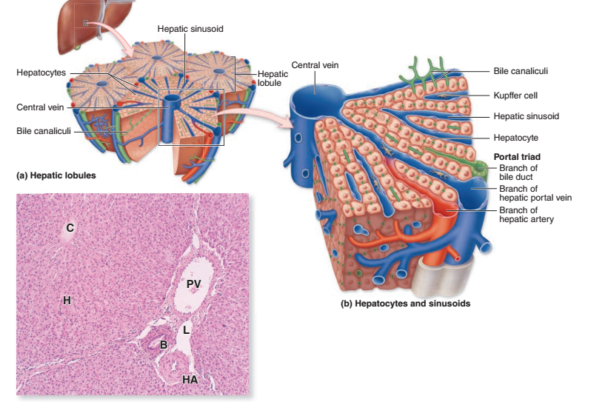
Cells in the canal of Hering is consider as stem cells that paly arole in liver regeneration.

Slide 19
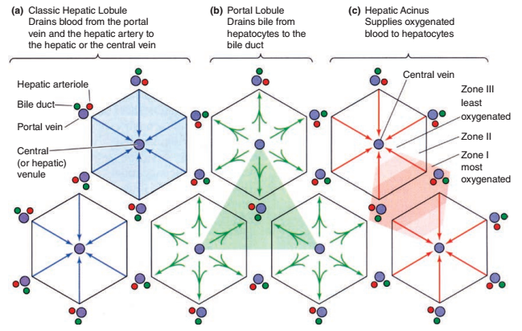
Hepatic lobulation
Three classification of hepatic lobules refer to different aspects of hepatocyte activities:
1.The classic hepatic lobule
2.Portal lobule
3.Liver acinus

Slide 20
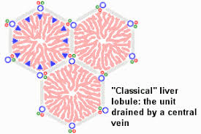
1.The classic hepatic lobule
It is a hexagonal mass of hepatocytes radiating around a central vein
Center: central vein
Corner: the portal canals, enclosing the portal traid, contain three structures:
1.An interlobular bile duct
2.An interlobular branch of hepatic artery
3.An interlobular branch of portal vein
In the classic hepatic lobule , blood and bile flow in opposite directions, the blood flow toward the central vein while the bile flow away from the central vein

Slide 21
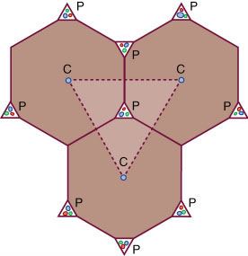
2.The Portal lobule
This is a triangular mass of hepatocytes from three adjacent
Classic hepatic lobules.
Center : a portal canal
Angles : the central vein
Each portal lobule drain bile into the central bile duct.

Slide 22
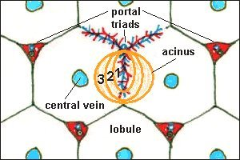
3.The liver acinus
It is the functional unit of the liver( correlate between metabolic activity, blood perfusion and liver pathology)
It is a diamond shape mass of two adjacent classic hepatic lobules.
Center: vascular core formed of branches from portal vein and hepatic artery, present along the border between two classic lobules.

Slide 23
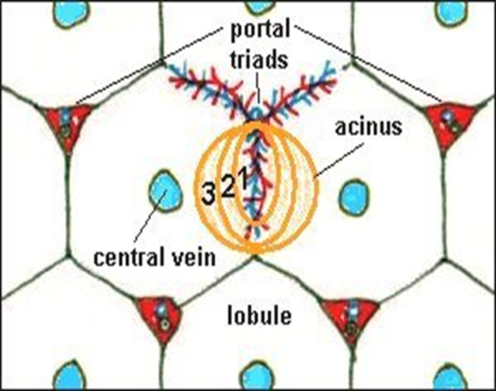
3.The liver acinus
It is divided into three zones according to their blood supply:
Zone 1 :
The hepatocyte close to the vascular core
It is richly supplied by blood
Its hepatocytes carry out oxidative metabolism and protein synthesis.
Zone 2 : hepatocytes intermediate in location and their blood supply
Zone 3 :
hepatocytes farthest from the blood
supply and close to the central vein
It has the poorest blood supply
Its hepatocytes carry out glycolysis
Its cells are the first that suffer from
degeneration and necrosis.

Slide 24
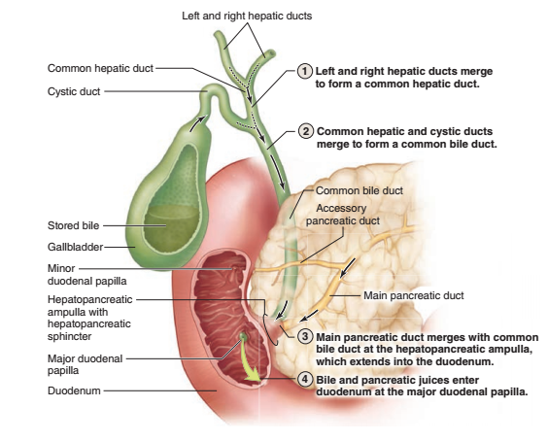
The gall bladder
Anatomically : it is a hollow, pear shaped organ
attached to the lower surface of the liver
Function: storage, concentration of bile and release of bile when
needed into the common bile duct

Slide 25
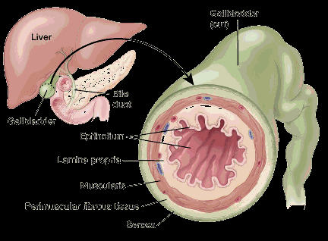
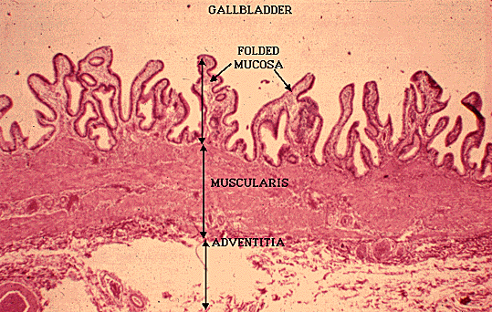
Structure of gall bladder
Three layers :
1.mucosa:
Highly folded especially when the gall bladder is empty
Epithelium: simple columnar epithelium with apical
microvilli( cholangiocytes) (for salt and water absorption)
Lamina propria: well vascularized
2.Muscularis :smooth muscle fiber arranged in several
Directions and separated by fibroelastic connective tissue
3.serosa/adventitia: according to anatomical surface

Slide 26
The biliary tract
The bile produced by the hepatocytes ﬂows through the bile
canaliculi, bile ductules, and bile ducts
These structures gradually merge,
forming a converging network that ultimately forms
the common hepatic duct, which joins the cystic duct from
the gallbladder and continues to the duodenum
as the common bile duct
The hepatic, cystic, and common bile ducts are lined with
a mucous membrane having a simple columnar epithelium of
cholangiocytes.
The lamina propria and submucosa are relatively thin,
with mucous glands in some areas of the cystic
duct, and surrounded by a thin muscularis
This muscle layer becomes thicker near the duodenum and finally,
in the duodenal papilla, forms a sphincter that regulates bile ﬂow into the
small bowel.

Slide 27
THANKS

